Slide 1
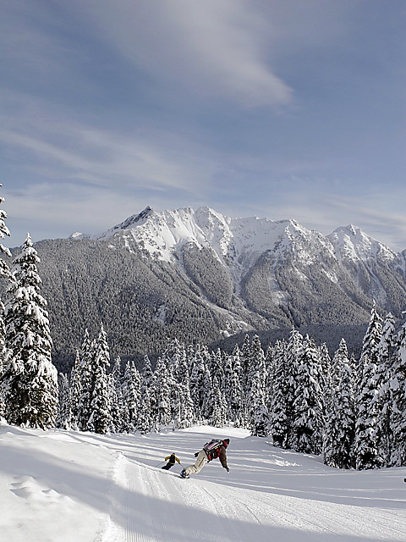
Big Mountain Ski Resort Analysis
Janis Navarro

Slide 2
Big Mountain Ski Resort
The purpose of this project is to produce a price model for ski resort tickets in the market segment.
Big Mountain Resort suspected they were not maximizing ticket profit returns, relative to its position in the market. They also did not have a strong sense of what facilities matter most to visitors and which are the most likely they are willing to pay more for.

Slide 3
Big Mountain Ski Resort
The pricing model built is a predictive model for ticket price based on nationwide ski resorts data based on the facilities available, property acres owned and what is valued most by visitors.
Big Mountain Ski Resort wanted to a pricing model for ski resort tickets to review current price and how it compares in its market segment.
The model will be used for recommendations on ski resort ticket pricing and provide additional guidance on future facility investment opportunities.

Slide 4
Predictive Pricing Model
The Predictive Pricing Model was trained and optimized with the provided nationwide resort data. The model provides analysis as to what Big Mountain Ski Resort’s ideal ticket price should be and how that can be impacted based on a change of different influential components known as Features.
Big Mountain Ski Resort’s current actual ticket price is at $81.00.
The model resulted in a ticket price of $95.87.
Even with the expected mean absolute error of $10.39, the model suggests there is room to increase the ticket price from its current actual ticket price of $81.00.

Slide 5
Predictive Pricing Model
From the Best Random Forest Regressor Feature, we used the most important Features that visitors are willing to pay more for as follows:
Vertical Drop
Snow Making Area
Total Number of Chairs
Fast Quads
Total Number of Runs
Longest Run in Miles
Trams
Skiable Terrain Area in Acres

Slide 6
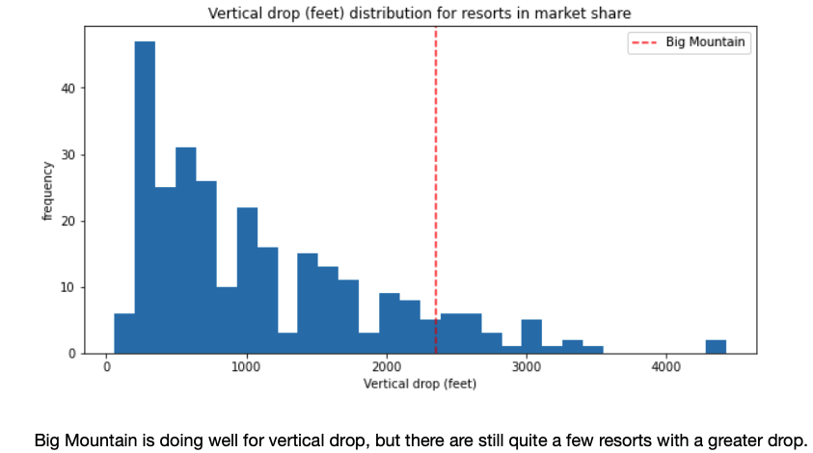
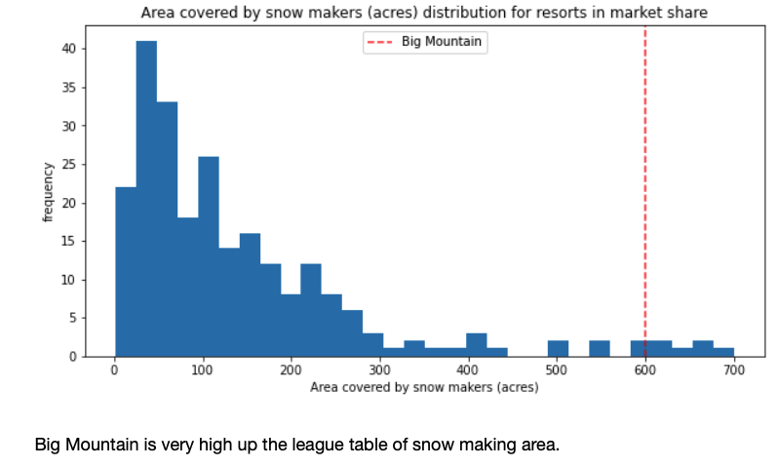
Vertical Drop Snow Making Area

Slide 7
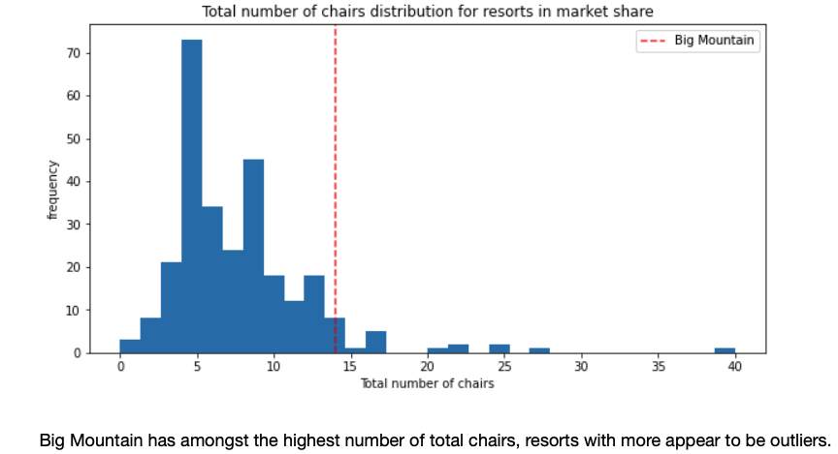
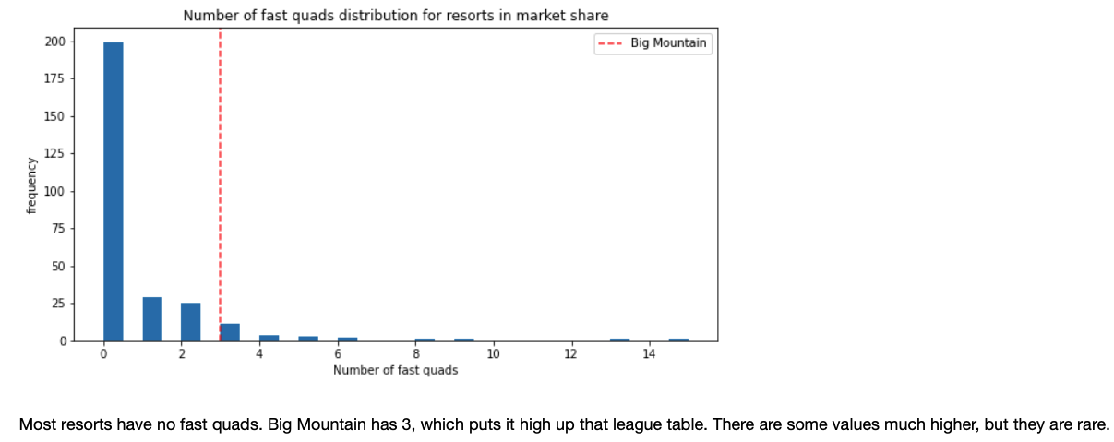
Total Number of Chairs Fast Quads

Slide 8
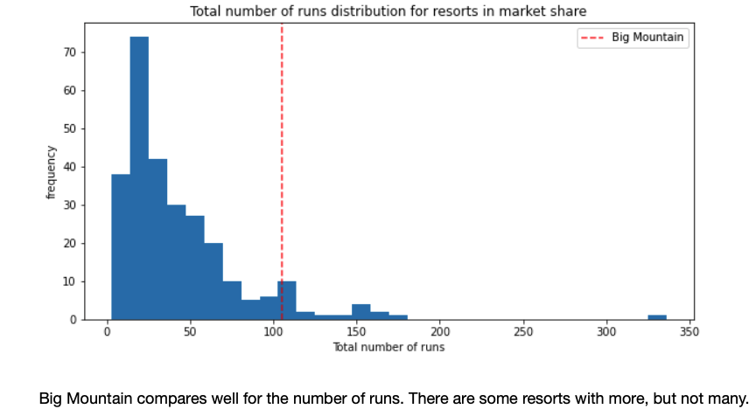
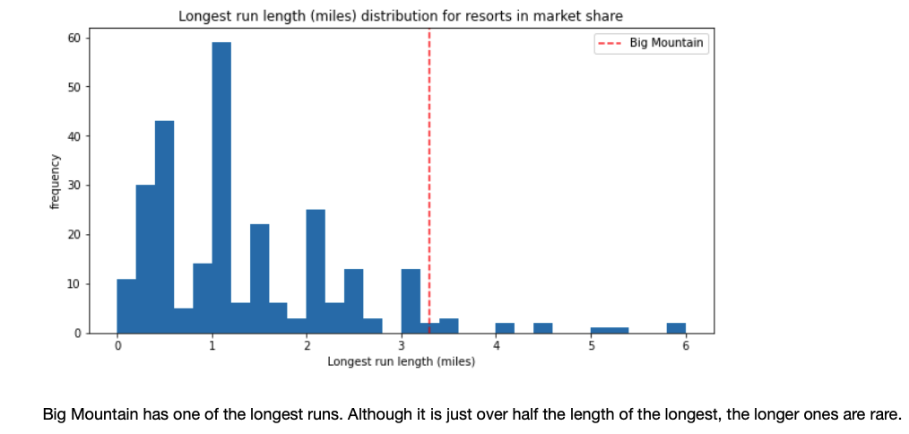
Total Number of Runs Longest Run in Miles

Slide 9
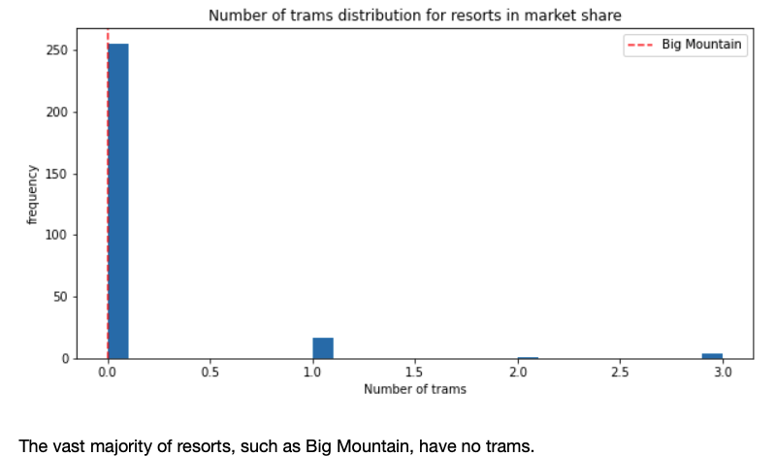
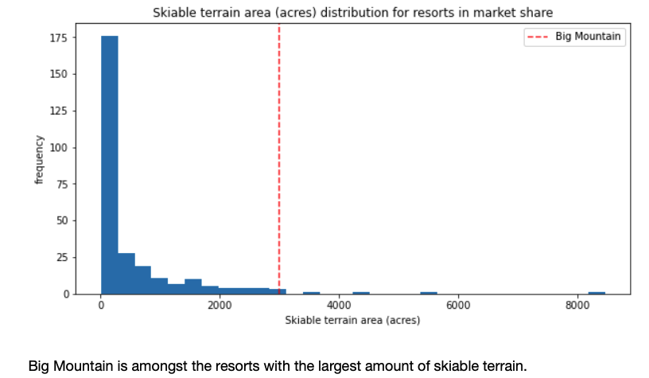
Trams Skiable Terrain Area in Acres

Slide 10
Recommendation & Key Findings
The analysis supports:
Big Mountain Ski Resort has all the top features and facilities that visitors are willing to pay more for.
Big Mountain ranks above average on seven of the eight most important features that impact ticket pricing.
This supports the model recommendation to increase ticket price to $95.87 or increase by at least $10.39 from $81.00 to $91.39.
The model also created various feature modification scenarios that provided the following key findings:
Close runs strategically to use open runs to full capacity
Assuming each run requires the use of a chair lift, each chair lift has an operating cost of $1,540,000.
The model recommends Big Mountain should close 3 to 5 runs to keep decrease costs without making an impact on the ticket revenues or the visitor’s experience.
Increasing ticket price in the future
Explore increasing maximum vertical drop by 150 feet
Continue to evaluate data for future opportunities

Slide 11
Conclusion
Big Mountain Ski Resort should increase its ticket price from the actual $81.00 to an approximate recommended range of $91 to $95.
This recommendation is based on nationwide data as provided by each resort and does not take consideration of State or influences where there are competitor resorts within a certain geographical approximation to Big Mountain Ski Resort.

